Slide 1


Physics (PHY 102) Physical Optics
Farjana Yeasmin
Lecturer in Physics, Basic Science Division
World University of Bangladesh

Slide 2

Objectives
Physical Optics

Slide 3
Diffraction of Light
Imagine passing a monochromatic light beam through a narrow opening—a slit just a little wider than the wavelength of the light. Instead of a simple shadow of the slit on the screen, you will see that an interference pattern appears, even though there is only one slit.
In the chapter on interference, we saw that you need two sources of waves for interference to occur. How can there be an interference pattern when we have only one slit? In The Nature of Light, we learned that, due to Huygens’s principle, we can imagine a wave front as equivalent to inﬁnitely many point sources of waves. Thus, a wave from a slit can behave not as one wave but as an infinite number of point sources. These waves can interfere with each other, resulting in an interference pattern without the presence of a second slit. This phenomenon is called diffraction.
Another way to view this is to recognize that a slit has a small but finite width. In the preceding chapter, we implicitly regarded slits as objects with positions but no size. The widths of the slits were considered negligible. When the slits have finite widths, each point along the opening can be considered a point source of light—a foundation of Huygens’s principle. Because real-world optical instruments must have finite apertures (otherwise, no light can enter), diffraction plays a major role in the way we interpret the output of these optical instruments. For example, diffraction places limits on our ability to resolve images or objects. This is a problem that we will study later in this chapter.

Slide 4
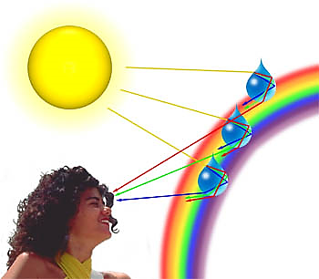
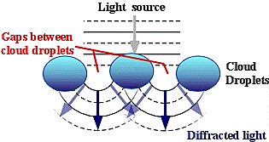
Diffraction of light
Diffraction of light is defined as the bending of light around corners such that it spreads out and illuminates areas where a shadow is expected. In general, it is hard to separate diffraction from interference since both occur simultaneously.
When the sunlight passes through or encounters the cloud, a rainbow is seen in the sky.

Slide 5
Diffraction of light
What is Diffraction?
The phenomenon of flaring out of light along the sides or edges of a body is called diffraction of light. As the wavelength increases this power of flaring out increases.

Slide 6
Diffraction of light-conditions
Conditions of diffraction:
In case of straight edge: The edge should be very sharp and its width is to be equal to or is of the order of the wavelength of light.
In case of thin hole: The diameter of the hole should be extremely small such that it is equal to or is of the order of the wavelength of light.

Slide 7
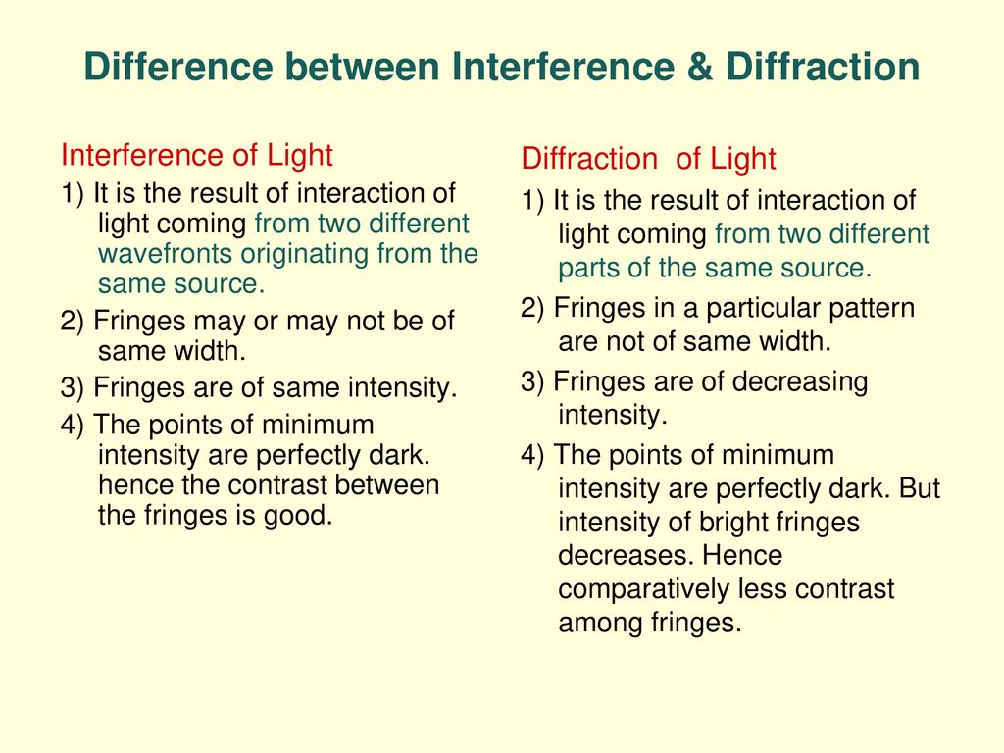
Difference-interference and diffraction
Difference between interference and diffraction

Slide 8
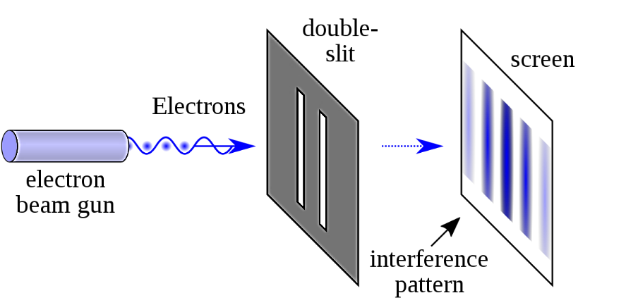
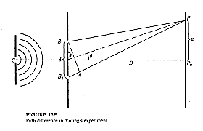
Young’s double slit experiment

Slide 9
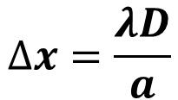
Young’s double slit experiment-formula
$$∆x=\frac{λD}{a}$$
Δ𝑥= Fringe separation
𝑎= Distance between the slits
𝐷= Distance of the screen from the slit
𝜆= Wavelength

Slide 10
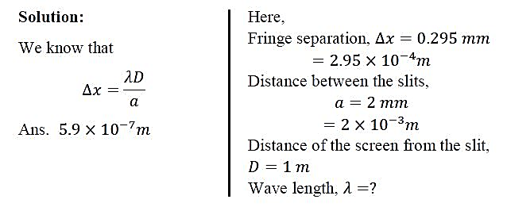
Mathematical problems
Q1. In Young’s double slit experiment the distance between two slits is 2.0 mm. The separation between two consecutive fringes at a distance 1 m from the slits is found to be 0.295 mm. Find the wavelength of light.

Slide 11
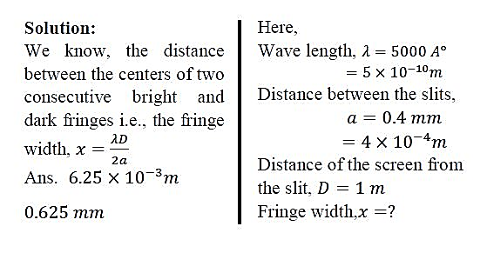
Mathematical problems
Q2. Interference fringes are produced on a screen kept at 1 m away from two slits 0.4 mm apart. The wavelength of the light used is 𝟓𝟎𝟎𝟎 𝑨°. Find the distance between the center of two consecutive bright and dark fringe.

Slide 12
Conclusions
Thank you

